Slide 1
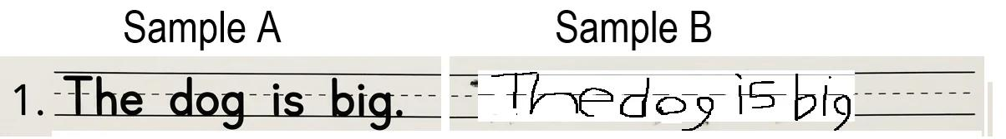
Q1 - TEACHING
Which sentence has letters that are clearer?
A. Sample A - letters are unclear
C. Both are the same
B. Sample B - letters are unclear
D. Neither has unclear letters

Slide 2
Q1 - ANSWER ✓
In Sample B, some letters don't look as clear. Letters like the "d" and "g" are a little messy. In Sample A, every letter is easy to see. When we write, we want people to be able to read our letters clearly.
B. Sample B - letters are unclear ✓
Next Question →

Slide 3
Q2 - TEACHING
Which letter in sample B is the hardest to read?
A. The "R" is unclear
C. The "W" is unclear
B. The "d" is unclear
D. All letters are clear

Slide 4
Q2 - ANSWER ✓
Good eye! The "d" doesn't look quite like it should. When we write, each letter needs to look like the letter in a book. If a letter looks different, people might not understand it.
B. The "d" is unclear ✓
Next Question →

Slide 5
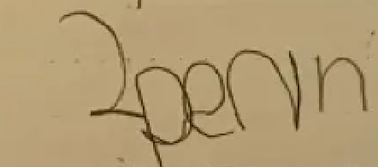
Q3 - TEACHING
Look at your own handwriting. Which letter could be clearer?
[IMAGE: Not found]
A. All of the letters are too close together
C. Everything is fine
B. The “n”s in in “pen” are too many and mispelled
D. Both A & B

Slide 6
Q3 - ANSWER ✓
Great noticing! You're learning to spot which letters need to be clearer. When you write your next sentence, pay extra attention to making that letter look clear.
D. Any answer - Student assessment
Next Question →

Slide 7
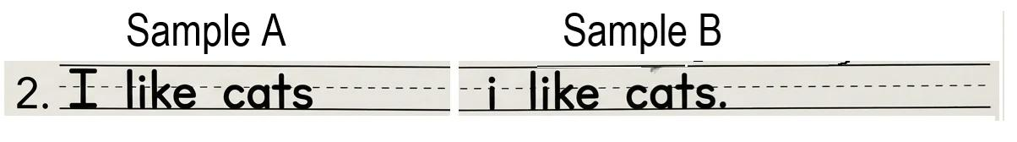
Q4 - TEACHING
Which sentence has bad capitalization?
A. Sample A
C. Both have good capitalization
B. Sample B
D. Neither have good capitalization

Slide 8
Q4 - ANSWER ✓
In Sample B, the first letter is “ i ” instead of “I”. The first Letter in every sentence must be capitalized.
A. Sample A – Has good capitalization
Next Question →

Slide 9
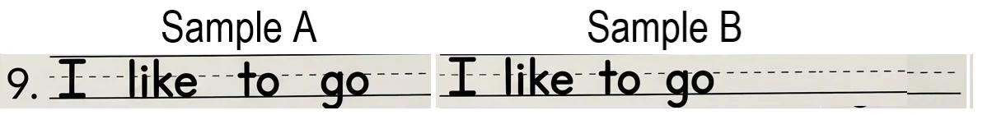
Q5 - TEACHING
Which words in this sentence are TOO Far?
A. Sample A
C. Both
B. Sample B
D. Neither

Slide 10
Q5 - ANSWER ✓
See how those first words are spread so far apart? Large gaps make it difficult to make full sentences
A. Sample A- Words are too far apart
Next Question →

Slide 11
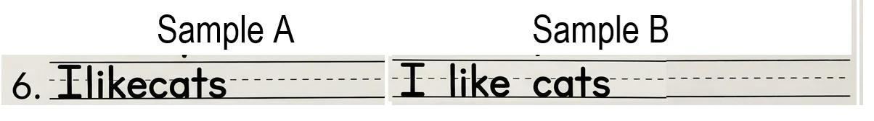
Q6 - TEACHING
Which sentence shows GOOD word spacing?
A. Sample A
C. Both
B. Sample B
D. Neither

Slide 12
Q6 - ANSWER ✓
Sample B is PERFECT! The words are spaced just right - not too close, not too far. You can clearly see where each word begins and ends. Sample A is one long word. Sample C has the words floating too far apart. Good spacing = easy to read!
B. Sample B- good spacing ✓
Next Question →

Slide 13
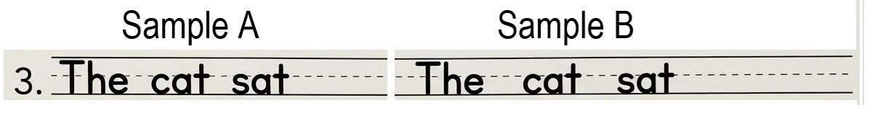
Q7 - TEACHING
Which sentence has letters that jump UP and DOWN instead of staying on the line?
A. Sample A - letters jump around
C. Both jump the same
B. Sample B - letters jump around
D. Neither one jumps

Slide 14
Q7 - ANSWER ✓
Look at Sample B - Neither words float UP and some words dip DOWN. The writing does stay on the line.
D. Neither jump around ✓
Next Question →

Slide 15
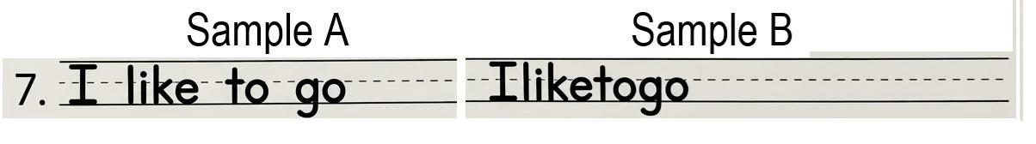
Q8 - TEACHING
Which word in this sentence is floating above or below the line?
A. Sample A
C. Both
B. Sample B
D. Neither

Slide 16
Q8 - ANSWER ✓
Perfect! The neither word kind are floats away. But Sample B’s letters are incorrect because they are too close together. When we write, all our letters should start on the same line and STAY there AND not be too closer together. If letters float up or down, it looks messy and is hard to read.
D. Neither is floating, but Sample B’s words are too close
Next Question →

Slide 17
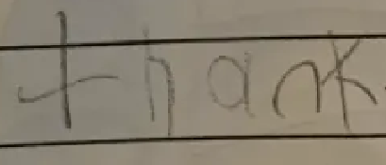
Q9 - TEACHING
Look at your handwriting. Do your letters stay on the line?
[IMAGE: Not found]
A. Yes, they stay on the line
C. They all float up
B. Some float up
D. They all float down

Slide 18
Q9 - ANSWER ✓
Good thinking! When you write next, try to trace the line with your pencil as you go. This will help you remember to keep your letters sitting right ON the line, not above or below it.
C. They all Float up
Next Question →

Slide 19
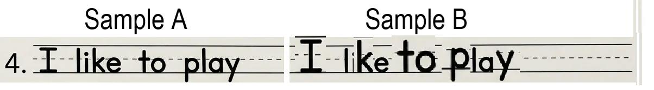
Q10 - TEACHING
Which sentence has letters that are all the SAME SIZE?
A. Sample A - same size
C. Both have same sizes
B. Sample B - same size
D. Neither has consistent size

Slide 20
Q10 - ANSWER ✓
Sample A is PERFECT! All letters are about the same height and width. Sample B has some big letters and some tiny letters. When letters are all the same size, writing looks neat and organized. Big letters mixed with tiny letters can make it look messy.
A. Sample A - same size ✓
Next Question →

Slide 21
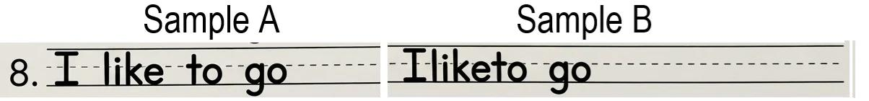
Q11 - TEACHING
Which letters are TOO BIG or TOO SMALL?
A. Sample A
C. Both
B. Sample B
D. Neither

Slide 22
Q11 - ANSWER ✓
Great catch! All letters are the same size. But Sample B’s are too closer . All your letters should be in the same "size family“ and they should be equally based so they look like they belong together.
D. Neither – Sample B has words that are too close but not too big
Next Question →

Slide 23
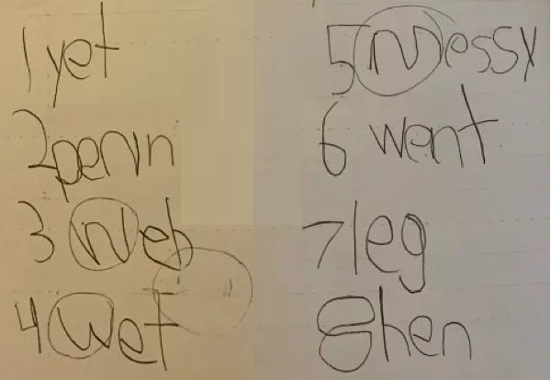
Q12 - TEACHING
Look at your handwriting. Are your letters all about the same size?
[IMAGE: Not found]
A. Yes, all same size
C. All are bigger
B. Some are bigger
D. All are smaller

Slide 24
Q12 - ANSWER ✓
Perfect - you're learning to spot size differences! When you write, try to keep all your letters in about the same size. Imagine them standing in a row - they should all be about the same height.
B. Some are bigger
Next Question →

Slide 25
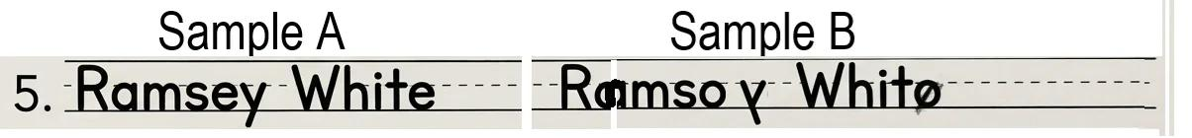
Q13 - TEACHING
Which name is written better?
A. Sample A - written well
C. Both are equally good
B. Sample B - written well
D. Neither is written well

Slide 26
Q13 - ANSWER ✓
Names are IMPORTANT! We need to write them carefully with a capital letter at the start. Sample A has a clear capital letter, good spacing, and consistent size. Sample B needs work in several areas. Your name deserves to look special and clear!
A. Sample A - written well ✓
Next Question →

Slide 27
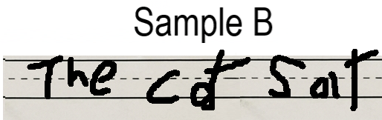
Q14 - TEACHING
What could be better about this Sentence? Pick ONE thing:
A. The letters are not capitalized
C. The letters are not on the line
B. The spacing between letters
D. All of the above

Slide 28
Q14 - ANSWER ✓
Smart thinking! Usually when a name isn't written as well as it could be, there's more work that you must fix. The good news? Now you know what to work on!
C. The letters are not on the line
Next Question →

Slide 29
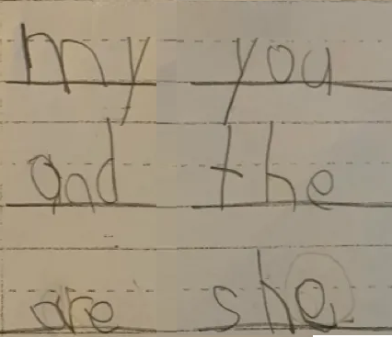
Q15 - TEACHING
Look at your Work. What did you do WELL? What could be better?
[IMAGE: Not found]
A. It’s perfect!
C. I’m not allowed to make mistakes
B. There were errors, but they were all corrected
D. It’s all wrong

Slide 30
Q15 - ANSWER ✓
Excellent! You're thinking like a writer! When you write your words next, remember all these things: capital letter, clear letters, good spacing, and consistent size. But don’t forget the most important thing. It’s okay to make mistakes! As long as you correct them.
This is how we learn and improve!
B. There were errors, but they were all corrected
Next Question →

Slide 31
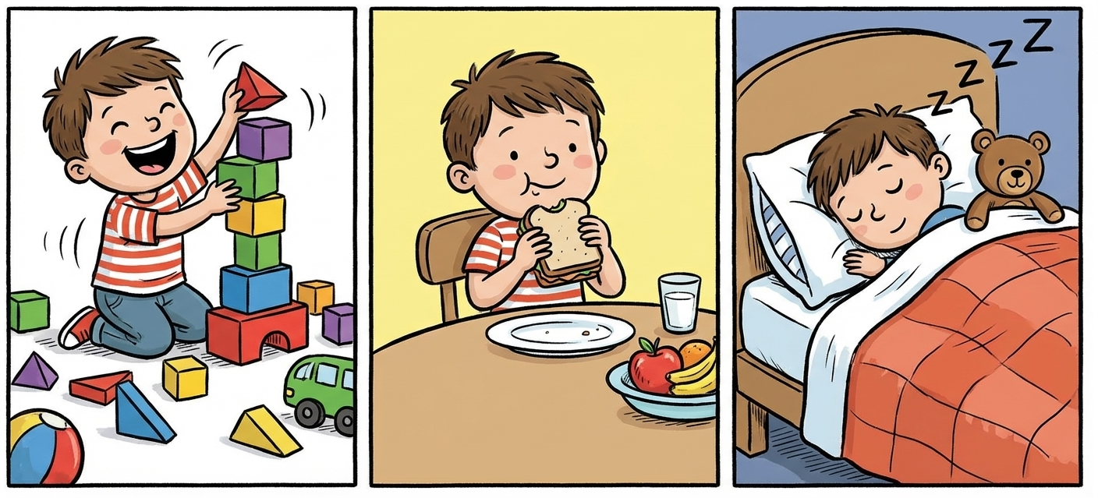
Q16 - TEACHING
Which story tells what happened in the right order?
[IMAGE: Not found]
A. "Last he ate. First he played. Then he slept."
C. Both are in order
B. "First, he played. Then he ate. Last he slept." ✓
D. Neither is in order

Slide 32
Q16 - ANSWER ✓
Sample B tells the events in the right order! First comes first, then comes next, and last comes last. Stories make more sense when events happen in the right order. Readers can follow what's happening!
B. "First he played. Then he ate. Last he slept." ✓
Next Question →

Slide 33
Q17 - TEACHING
Which sentence uses a TIME WORD to show order?
[IMAGE: Not found]
A. "He ate a sandwich."
C. “He slept."
B. "First, he played.”
D. There is no time word

Slide 34
Q17 - ANSWER ✓
Yes! The word "First" tells us WHEN something happens. Other time words are: Next, Then, After, Finally, Last. These words help readers know what happens in order!
B. "First, he played."
Next Question →

Slide 35
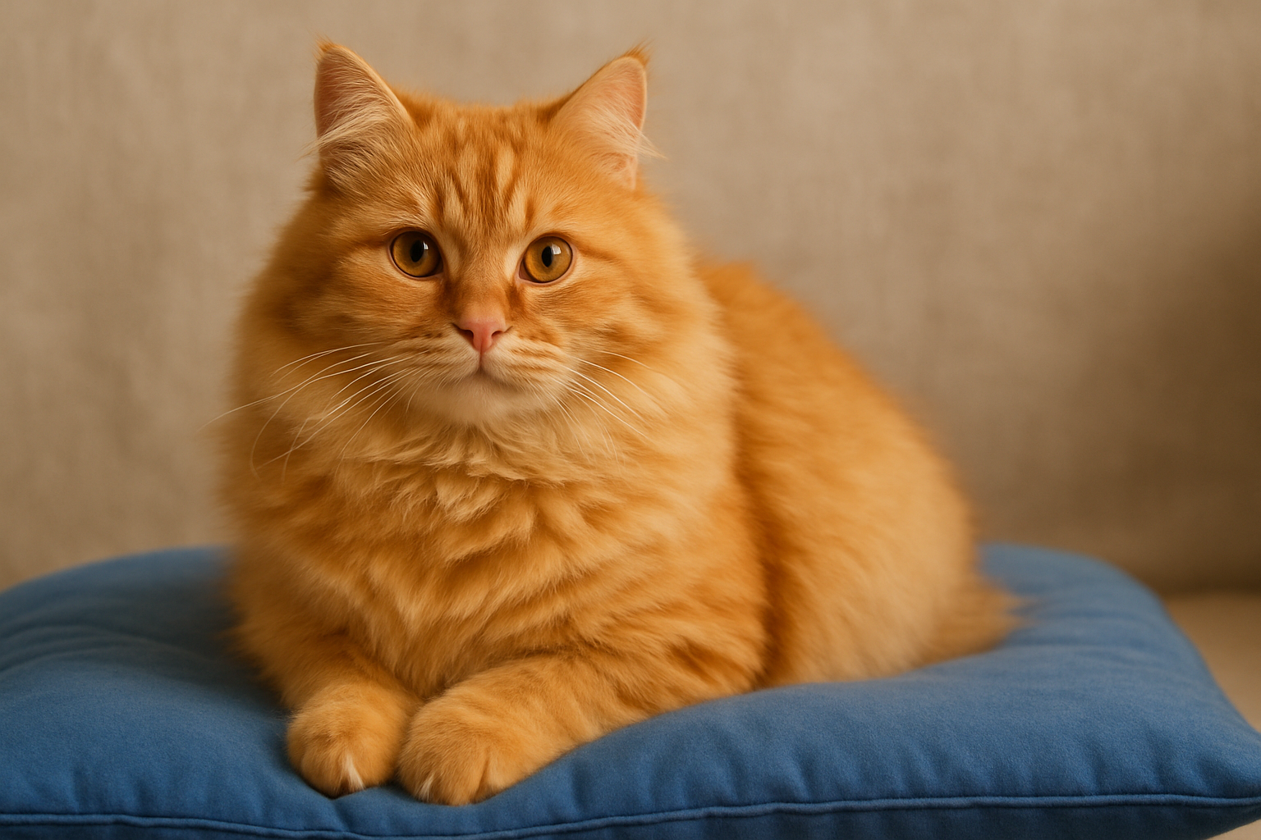
Q18 - TEACHING
Which sentence gives you a better picture of what happened?
[IMAGE: Not found]
A. "A cat sat down."
C. "The cat was there."
B. "A fluffy orange cat sat down on the soft blue pillow."
D. "A cat and a dog."

Slide 36
Q18 - ANSWER ✓
Sample B is much better! It tells you what the cat looks like (fluffy, orange) and what kind of pillow (soft, blue). When you add describing words, readers can SEE what you're writing about!
B. "A fluffy orange cat sat down on the soft blue pillow." ✓
Next Question →

Slide 37
Q20 - TEACHING
Which sentence tells what someone THINKS?
A. "Dogs have four legs."
C. "Cats are animals."
B. "I think dogs are the best pets." ✓
D. "The sky is blue."

Slide 38
Q20 - ANSWER ✓
Sample B is an OPINION - it tells what someone thinks or likes. Sample A is a FACT - it's true for everyone. Opinion writing starts with things like "I think," "I like," "I believe," "In my opinion."
B. "I think dogs are the best pets." ✓
Next Question →

Slide 39
Q21 - TEACHING
Which opinion tells a REASON why?
A. "I like ice cream."
C. "Ice cream is food."
B. "I like ice cream because it's cold and sweet."
D. "I think ice cream."

Slide 40
Q21 - ANSWER ✓
Sample B is MUCH BETTER! It tells your opinion AND your reason with the word "because." Always give a reason for your opinion. Tell WHY you think something - that makes your writing stronger!
B. "I like ice cream because it's cold and sweet." ✓
Next Question →

Slide 41
Q23 - TEACHING
Which one stays on the SAME TOPIC the whole time?
A. "Dolphins live in water. They are smart. Dolphins can do tricks." ✓
C. "Many animals are cool."
B. "Dolphins are smart. Dogs are fun. I like swimming."
D. "Animals, food, and games."

Slide 42
Q23 - ANSWER ✓
Sample A is FOCUSED! Every sentence teaches about dolphins. Sample A jumps around - dolphins, then dogs, then swimming. Good informative writing picks ONE topic and teaches about THAT topic the whole time!
A. "Dolphins live in water. They are smart. Dolphins can do tricks." ✓
Next Question →

Slide 43
ANSWER KEY REFERENCE - Keep for Your Files
Q1: B | Q2: B | Q3: Metacognitive | Q4: B | Q5: A | Q6: B
Q7: B | Q8: A | Q9: Metacognitive | Q10: A | Q11: A | Q12: Metacognitive
Q13: A | Q14: D | Q15: Metacognitive | Q16: B | Q17: B | Q18: B
Q19: Metacognitive | Q20: B | Q21: B | Q22: Metacognitive | Q23: B | Q24: Metacognitive

Slide 44
🎉 EXCELLENT WORK! 🎉
You learned about:
✓ Clear letter formation
✓ Good word spacing
✓ Staying on the line
✓ Consistent letter size
✓ Telling stories in order
✓ Giving opinions with reasons
✓ Teaching about topics
Now let's see what you can do!

Slide 45
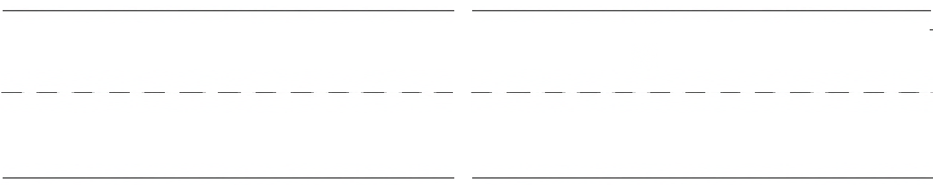
Q19 - TEACHING
Tell me what happened FIRST and what happened NEXT in something you did today.
1. Accept any two sequenced events
2. Used time words
3. Encourage describing words
4. (Metacognitive)

Slide 46
Q22 - TEACHING
What's YOUR opinion? Pick something you like and tell me WHY.
1. Must include opinion + reason
2. Use the word "because"
3. Accept any topic
4. (Metacognitive)

Slide 47
Q24 - TEACHING
Pick something you know about. Tell me ONE FACT about it.
1. Accept any fact about any topic
2. Any topic is good
3. Topic is Focused
4. (Metacognitive)

Slide 48
Q25- GUARDIAN ASSESSMENT: HANDWRITING
Child writes: His name + one sentence of your choice
☐ Letters are recognizable
☐ Letters are consistent size
☐ Words have space between them
☐ Name is written well
☐ Letters stay on the line
Scoring: _____ out of 5 criteria | Notes: _________________
Name:

Slide 49
Q26- GUARDIAN ASSESSMENT: NARRATIVE WRITING
Prompt: Tell me about something you did. What happened first? Next? Last?
☐ Tells who and where
☐ Includes details
☐ Events in order
☐ Uses capitals
Scoring: _____ out of 8 criteria
☐ Tells 2+ events
☐ Has an ending
☐ Uses time words
☐ Uses punctuation

Slide 50
Q27- GUARDIAN ASSESSMENT: OPINION & INFORMATIVE
OPINION: What's your favorite [thing]? Why?
☐ States opinion
☐ Names topic
☐ Supports opinion
☐ Stays focused
Scoring: _____ out of 8 criteria
☐ Gives reason
☐ Gives facts
☐ Uses capitals
☐ Ends well

